Slide 1

Day 3 Tutorial: Bayes Part 1
BAMB! Summer School

Slide 2

Tutorial overview
Basic Bayes
Bayes theorem
Bayesian Statistics
Using prior knowledge
Bayesian Observers
Neural orientation likelihoods
Cardinal prior
Biological implementation

Slide 3
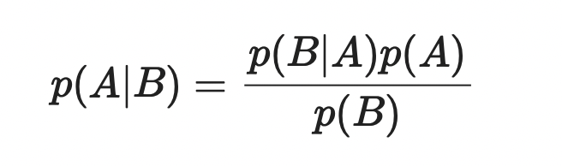
1. Basic Bayes
Simple statistics
Statistics over distributions
Using prior knowledge

Slide 4
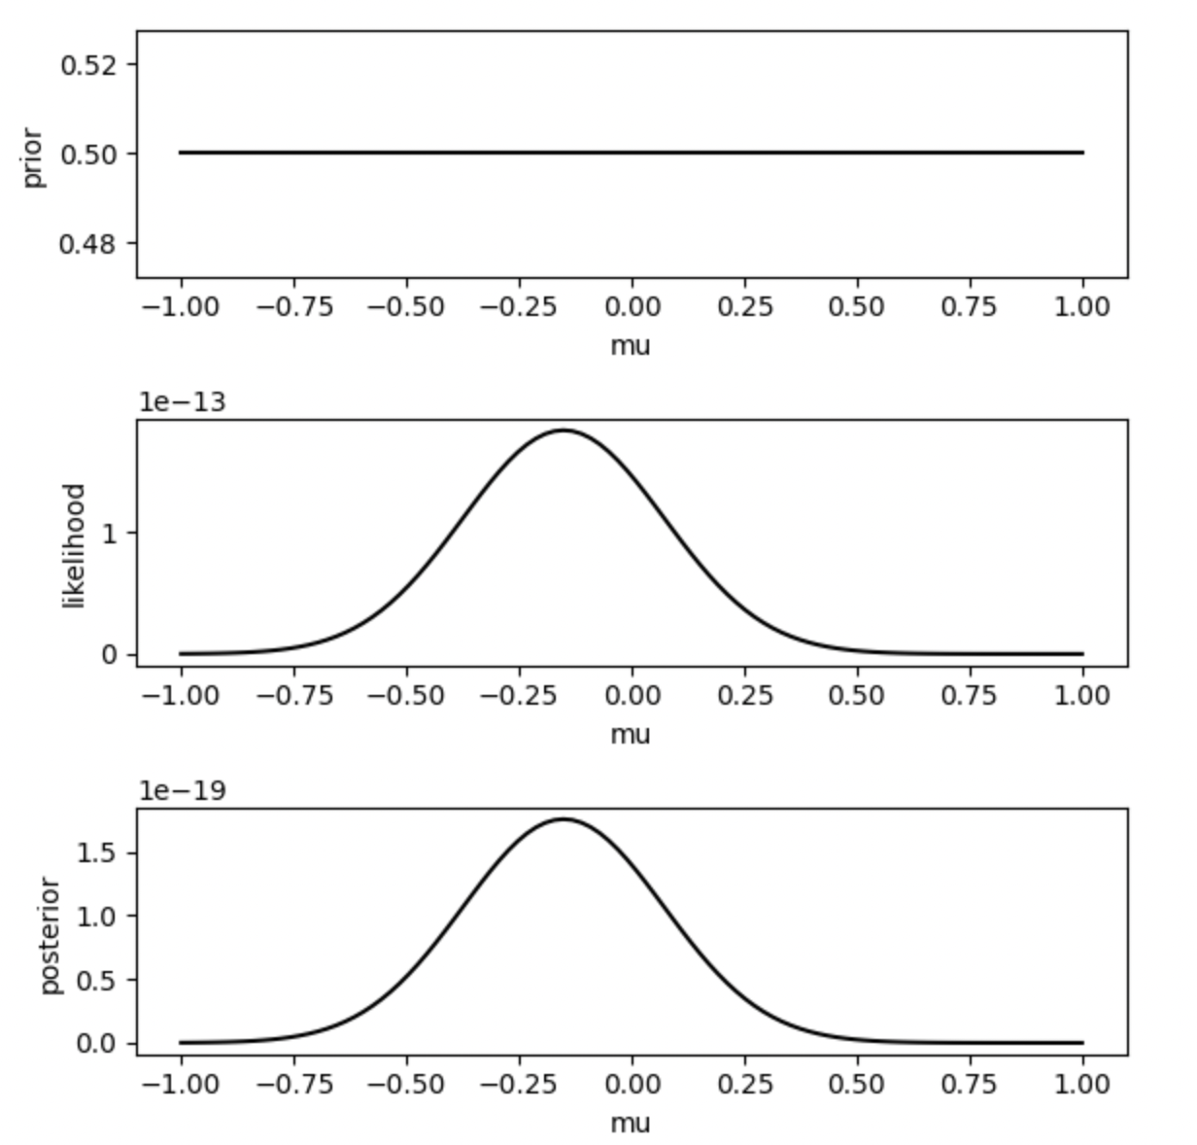
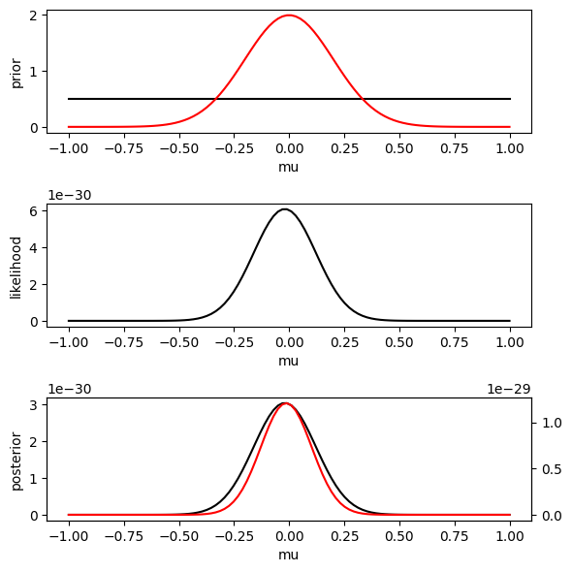
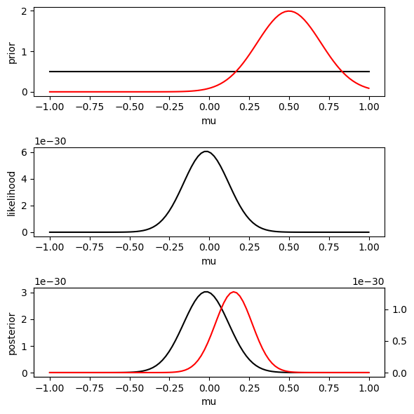
1. Basic Bayes

Slide 5
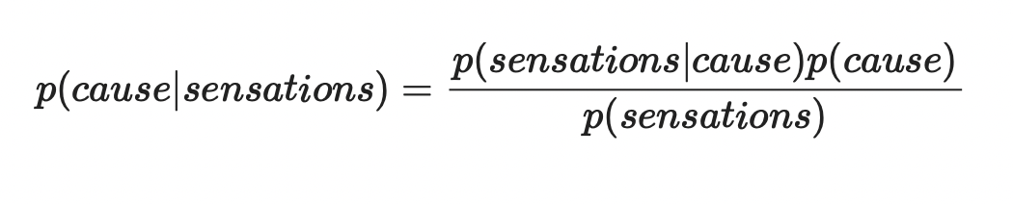
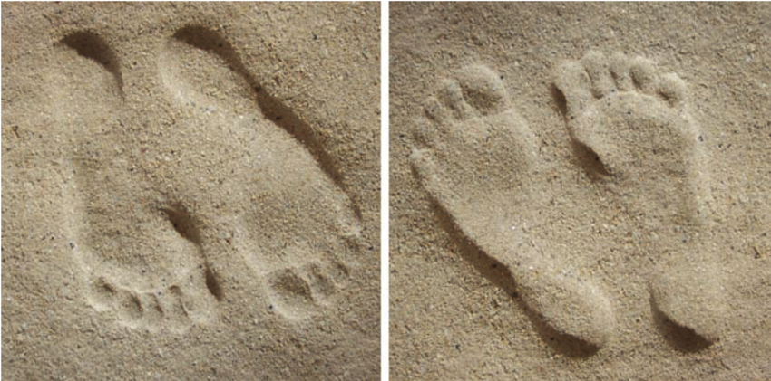
2. Bayesian Observers

Slide 6
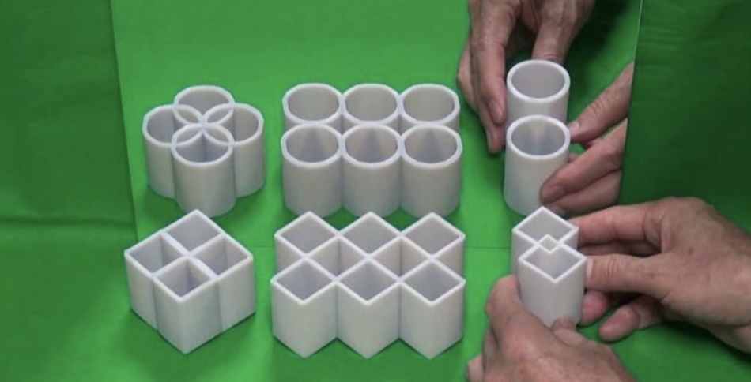
2. Bayesian Observers

Slide 7
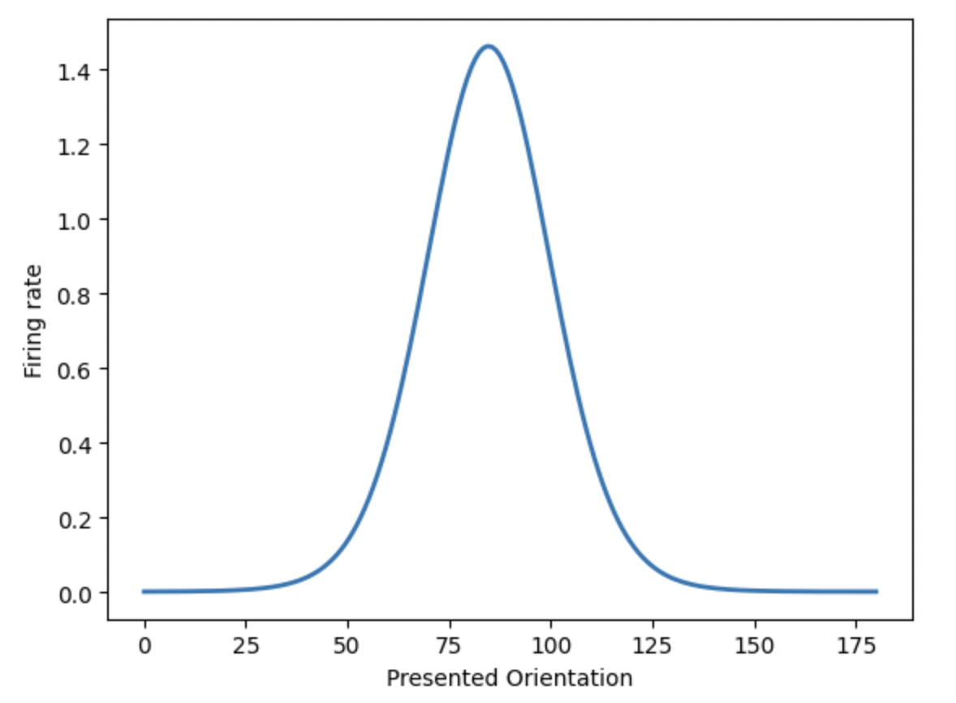
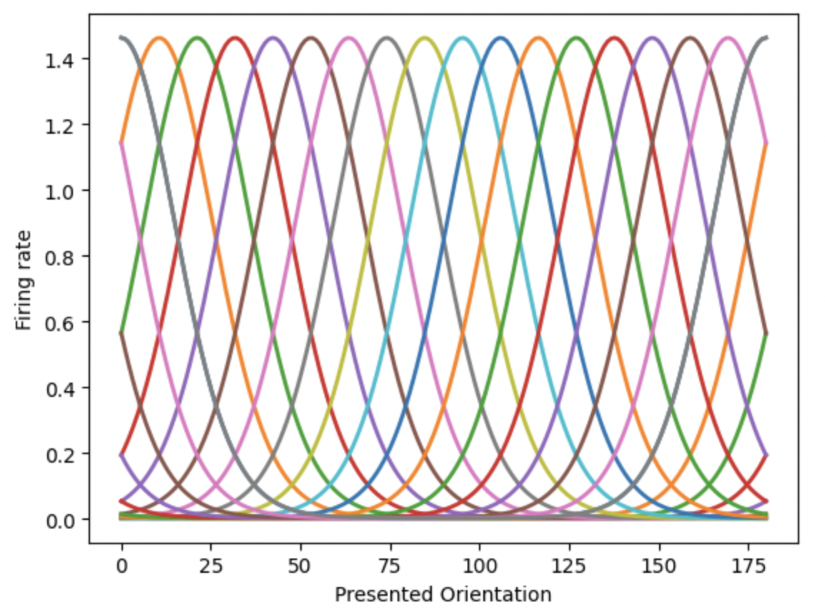
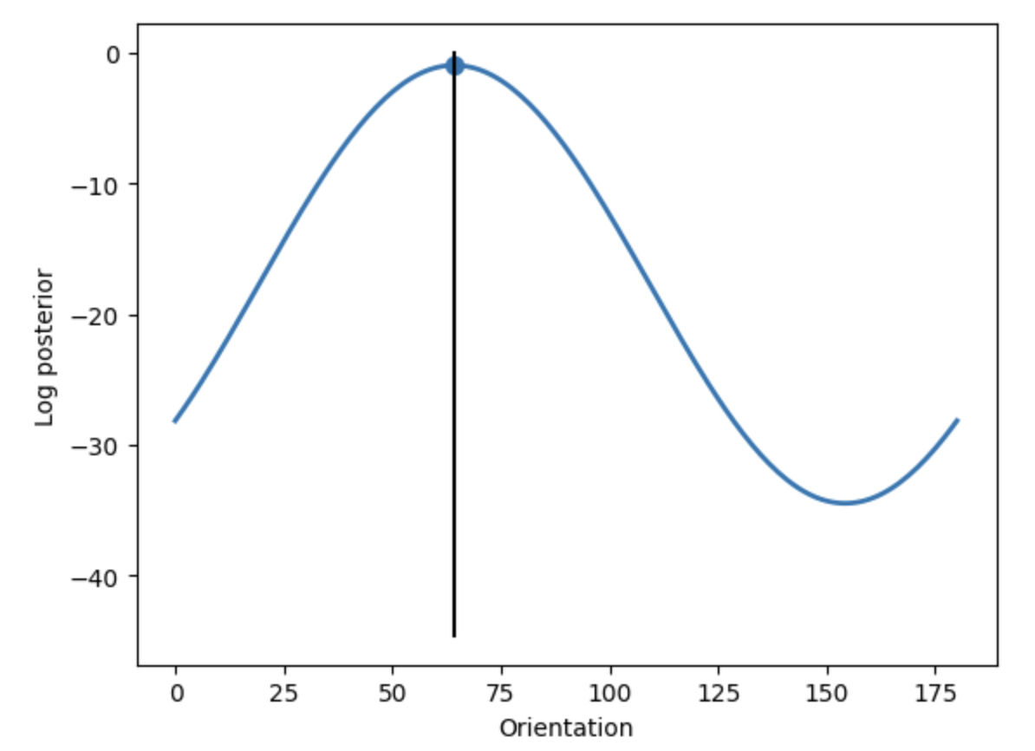
2. Bayesian Observers
Maximum a posteriori

Slide 8
Tutorial overview
Basic Bayes
Bayes theorem
Bayesian Statistics
Using prior knowledge
Bayesian Observers
Neural orientation likelihoods
Cardinal prior
Biological implementation

